Slide 1

Gophers, Concurrency and Parallelism
Gwendal Leclerc
@skillo1989 Go developer at OVH

Slide 2
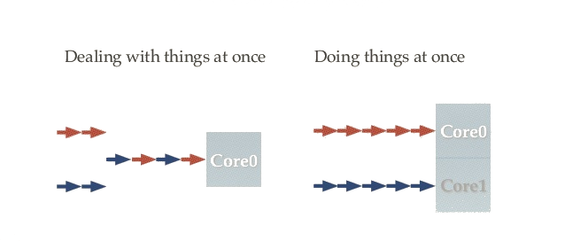
Concurrency vs Parallelism

Slide 3
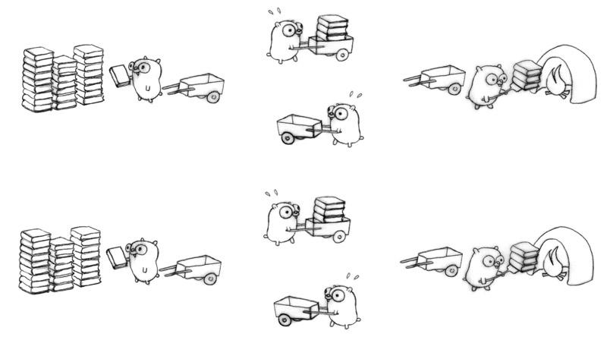
Concurrency with Parallelism

Slide 4
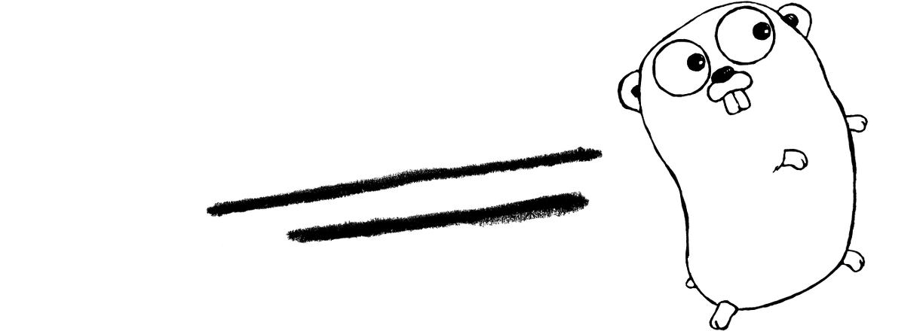

Channels
Can be viewed as a FIFO (first in, first out) message queue
Transfer ownership of data between goroutines
Composite types like array, slice and map
Have nil as zero value
Can be directional
chan T <=> Bidirectional channel
chan<- T <=> Send-only channel
Compiler doesn't allow receiving values
<-chan T <=> Receive-only channel
Compiler doesn't allow sending values
Can be buffered

Slide 5

Channels rules
Actions / Channels | Nil channel | Closed channel | Active channel
Close | panic | panic | close
Send to | block forever | panic | send or block
Receive from | block forever | never block (sending default value) | receive or block

Slide 6

Why those rules ?
To drive the way you code your programs
Only senders can know when they finished sending data
It’s only necessary to close a channel if the receiver is looking for a close (even if you’re looking for close most of the time)
It's OK to leave a Go channel open forever and never close it, if it’s not used and referenced anymore. It will be garbage collected.
But beware of memory leaks.

Slide 7
For-Range on Channels
for v = range aChannel { // use v }
is equivalent to
for { v, ok = <-aChannel if !ok {
// v take the zero value of the channel’s type break } // use v }

Slide 8
Select over Channels
messages := make(chan string) signals := make(chan bool)
select { case msg := <-messages: fmt.Println("received message", msg) case sig := <-signals: fmt.Println("received signal", sig) default: fmt.Println("other cases are blocked (waiting)") }

Slide 9
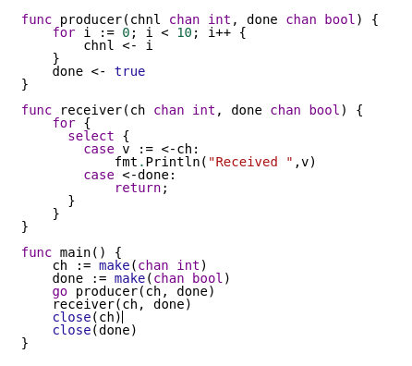

Bad Example

Slide 10

Bad Example

Slide 11
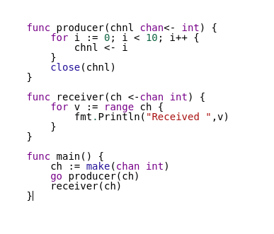
Correct way

Slide 12
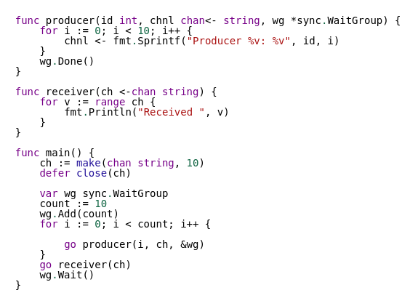
Deal with multiple senders (sync.WaitGroup)

Slide 13
Mutexes
Use mutexes, it's not bad
Mutexes will synchronize access to data
Mutexes are really cheap in the non-blocking case
“Threading isn’t hard — locking is hard.”
Channels | Mutexes
passing ownership of data distributing units of work communicate async results | Concurrent access to data (cache / state)

Slide 14
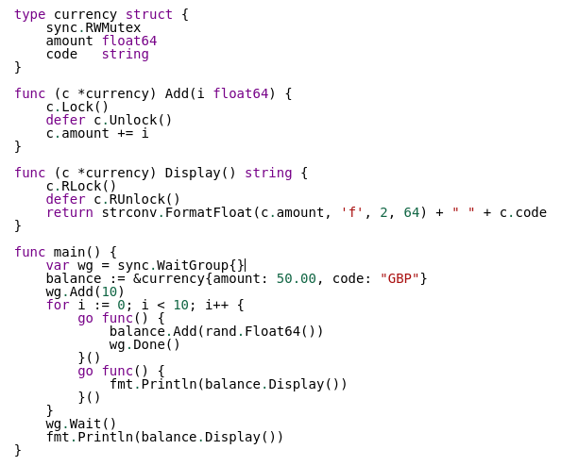
Warp mutexes into structures

Slide 15
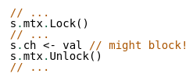
Mutexes rules
Don’t block inside a lock
Be careful when using it with channels (due to channels rules)
Use race detector https://golang.org/doc/articles/race_detector.html

Slide 16
Warnings
Keep lisibility and maintainability in mind
Concurrency is not simple even with channels
Using channel can break performance in some use cases
https://youtu.be/ySy3sR1LFCQ
Avoid concurrency in your API
https://talks.golang.org/2013/bestpractices.slide#25
Avoid goroutine leaks
https://medium.com/golangspec/goroutine-leak-400063aef468

Slide 17
To go further
How to wait for all goroutines to finish
JustForFunc Youtube
Channels are bad and you should feel bad
Dancing with go mutexes
Tapirgames blog golang channel

Slide 18

Questions ?

Slide 19

Thanks

